Slide 1
Data Analysis and Insights for different page Optimization & How to get more user install & Engagement from the App & Website

Slide 2
INTRODUCTION
2024
In this presentation, we delve into the intricacies of optimizing page performance and driving increased user installation and engagement for XYZ Inc., a fictional company. As part of the Business Analytics team, our primary goal is to extract actionable insights from a provided dataset encompassing user data, regional demographics, product details, and marketing campaign specifics. Our analysis focuses on identifying pivotal factors that influence page optimization and formulating strategies to bolster user installation and engagement across both the App and website platforms. We begin by exploring the dataset's nuances, highlighting its significance in understanding user behavior and preferences. Subsequently, we dissect factors crucial to page optimization, including website/app design, user experience, content relevance, and loading speed, illustrating their impact on user engagement and retention with real-world examples. Following this, we propose strategies tailored to enhance user installation, emphasizing targeted marketing campaigns, user-friendly interfaces, and personalized promotions. Moreover, we explore tactics for boosting user engagement, such as interactive content, social media integration, and gamification elements, all aimed at fostering a vibrant user community and driving repeat visits. Throughout, we underscore the importance of data-driven decision-making and iterative optimization efforts in achieving sustained success. We conclude by summarizing key insights and recommendations, inviting further discussion and collaboration to refine our approach towards achieving XYZ Inc.'s objectives.

Slide 3
Generate actionable insights to optimize page performance
Page Optimization Analysis:
Exploratory Data Visualization:
Conduct a detailed analysis of different pages on the app and website.
Evaluate the performance of each page in terms of user engagement and conversion rates.
Identify pages with high bounce rates or low conversion rates that require optimization.
Create visualizations to gain insights into relationships and patterns within the data.
Explore temporal patterns using time series plots for datetime variables.
Visualize distributions and trends across different categories using bar plots, box plots, or line plots.

Slide 4
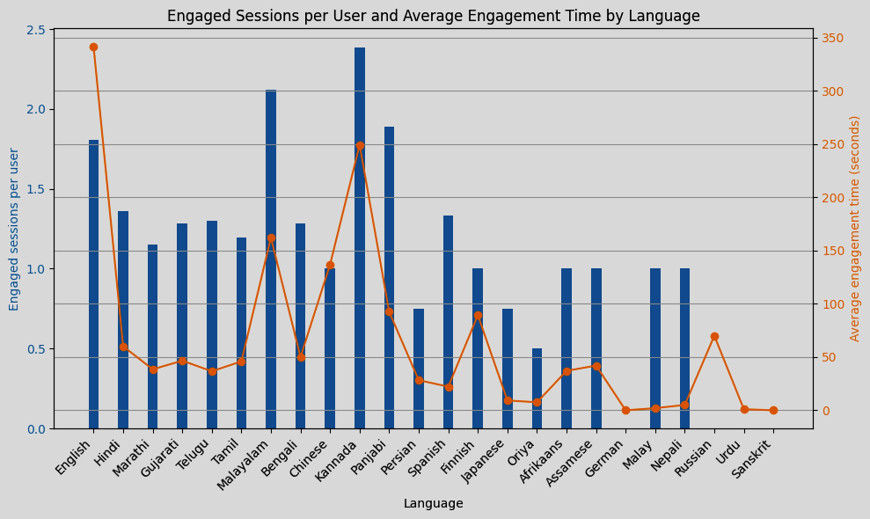
Data Exploratory & Analysis
Engaged sessions per user and average engagement time by language

Slide 5
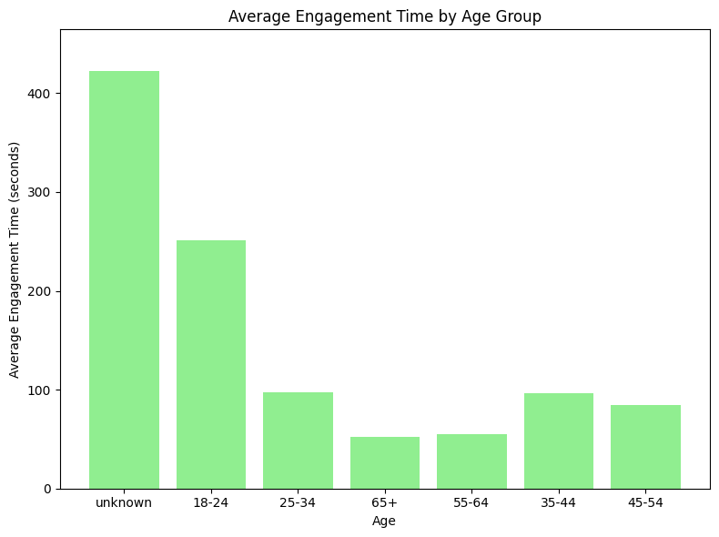
Descriptive Analysis
Summary: Summarizing the main characteristics of the data.
Overview: Providing an overview or general understanding of the dataset.
Statistics: Calculating descriptive statistics such as mean, median, mode, standard deviation, etc.
Distribution: Examining the distribution of data points across different variables.
Trends: Identifying trends or patterns within the data.
Patterns: Detecting patterns or relationships between variables.
Frequency: Analyzing the frequency of occurrence of different values or categories.
Central Tendency: Understanding the central tendency of the data, such as the mean or median.
Variability: Assessing the variability or dispersion of data points around the central tendency.
Range: Examining the range of values covered by the dataset.
Outliers: Identifying outliers or extreme values that may indicate anomalies in the data.
Correlation: Exploring the correlation or relationship between variables.
Visualization: Creating visual representations, such as charts or graphs, to illustrate key insights.
Insights: Drawing insights or conclusions from the descriptive analysis.
Comparison: Comparing different groups or categories within the dataset.
Distribution Shape: Describing the shape of the distribution, e.g., normal, skewed, bimodal, etc.
Summary Measures: Using summary measures like quartiles, percentiles, or interquartile range.
Data Quality: Assessing the quality and integrity of the data.
Segmentation: Segmenting the data based on different criteria for deeper analysis.
Documentation: Documenting the findings and methodology of the descriptive analysis.

Slide 6
Recommendations
2024
Chart Title
Identify Target Customer Segments:
Analyze customer demographics, purchasing behavior, and preferences to identify high-value customer segments.
Tailor marketing strategies and product offerings to meet the specific needs and preferences of each segment.
Use data segmentation techniques to personalize marketing messages and promotions.

Slide 7






Deliverables
Data Analysis Report
Strategic Plan Presentation:
Clear Objectives and Scope
Insights on sales performance, customer behavior, market trends, and other relevant metrics.
Highlights key areas of focus, such as target customer segments, marketing strategies, product offerings, and sales processes.
Ensure that deliverables align with the project goals and address key business needs.
Actionable Insights and Recommendations:
Timeliness and Milestones:
Relevance and Impact:
Offer concrete recommendations that stakeholders can implement to achieve desired outcomes.
Monitor progress regularly and address any delays or issues proactively to keep the project on track.
Prioritize deliverables that have the highest potential for driving positive outcomes or mitigating risks.

Slide 8
THANK YOU!
2024
Rakul K

